Slide 1
Digital Portfolio
STUDENT NAME: DANIALJOHNSON P
REGISTER NO :24BSDS113
NMID:254B30C5DD47606933A4FBD52D2A0420
DEPARTMENT: B.SC DATA SCIENCE
COLLEGE: SRI KRISHNA ADITHYA COLLEGE OF ARTS AND SCIENCE UNIVERSITY:BHARATHIYAR UNIVERSITY

Slide 2
PROJECT TITLE MY PORTFOLIO

Slide 3


AGENDA
Problem Statement
Project Overview
End Users
Tools and Technologies
Portfolio design and Layout
Features and Functionality
Results and Screenshots
Conclusion
Github Link
3/21/2024 Annual Review

Slide 4

PROBLEM STATEMENT
In today’s digital world, students and professionals need an online presence.
Traditional resumes alone are not enough to showcase projects and skills.
A personal portfolio website solves this problem by acting as a digital resume + project showcase.

Slide 5

PROJECT OVERVIEW
The project is a personal portfolio website developed using HTML, CSS, and JavaScript.
Hosted on CodePen/GitHub Pages for easy access.
Main sections:
Hello statement, About Me, Projects, Contact Form, Footer.

Slide 6

WHO ARE THE END USERS?
Students – to display their projects & learning journey.
Recruiters/Employers – to quickly review candidate’s profile.
Faculty/Guides – for academic evaluation.
Self – to build personal branding and visibility.

Slide 7

TOOLS AND TECHNIQUES
Frontend Languages:
HTML – Page Structure
CSS – Styling and responsive design
JavaScript – Interactivity (form handling,dynamic footer year)
CodePen – Development and live preview
Image Hosting: i.ibb.co

Slide 8
POTFOLIO DESIGN AND LAYOUT
Header – Title, Hello statement, “View My Work” button.
About Me – Profile photo (centered), short 2-line intro (Data Science student).
Projects Section – 3 horizontal cards: Food Ordering App, My Portfolio, Gate Sensor.
Contact Section – Name, Email, Phone input fields + Send button.
Footer – Copyright with current year.
8

Slide 9
FEATURES AND FUNCTIONALITY
Responsive design – works on both desktop & mobile.
Smooth scroll to Projects section from “View My Work” button.
Contact form with prefilled details.
Footer updates year automatically using JavaScript.
Clean, minimal, and user-friendly design.

Slide 10
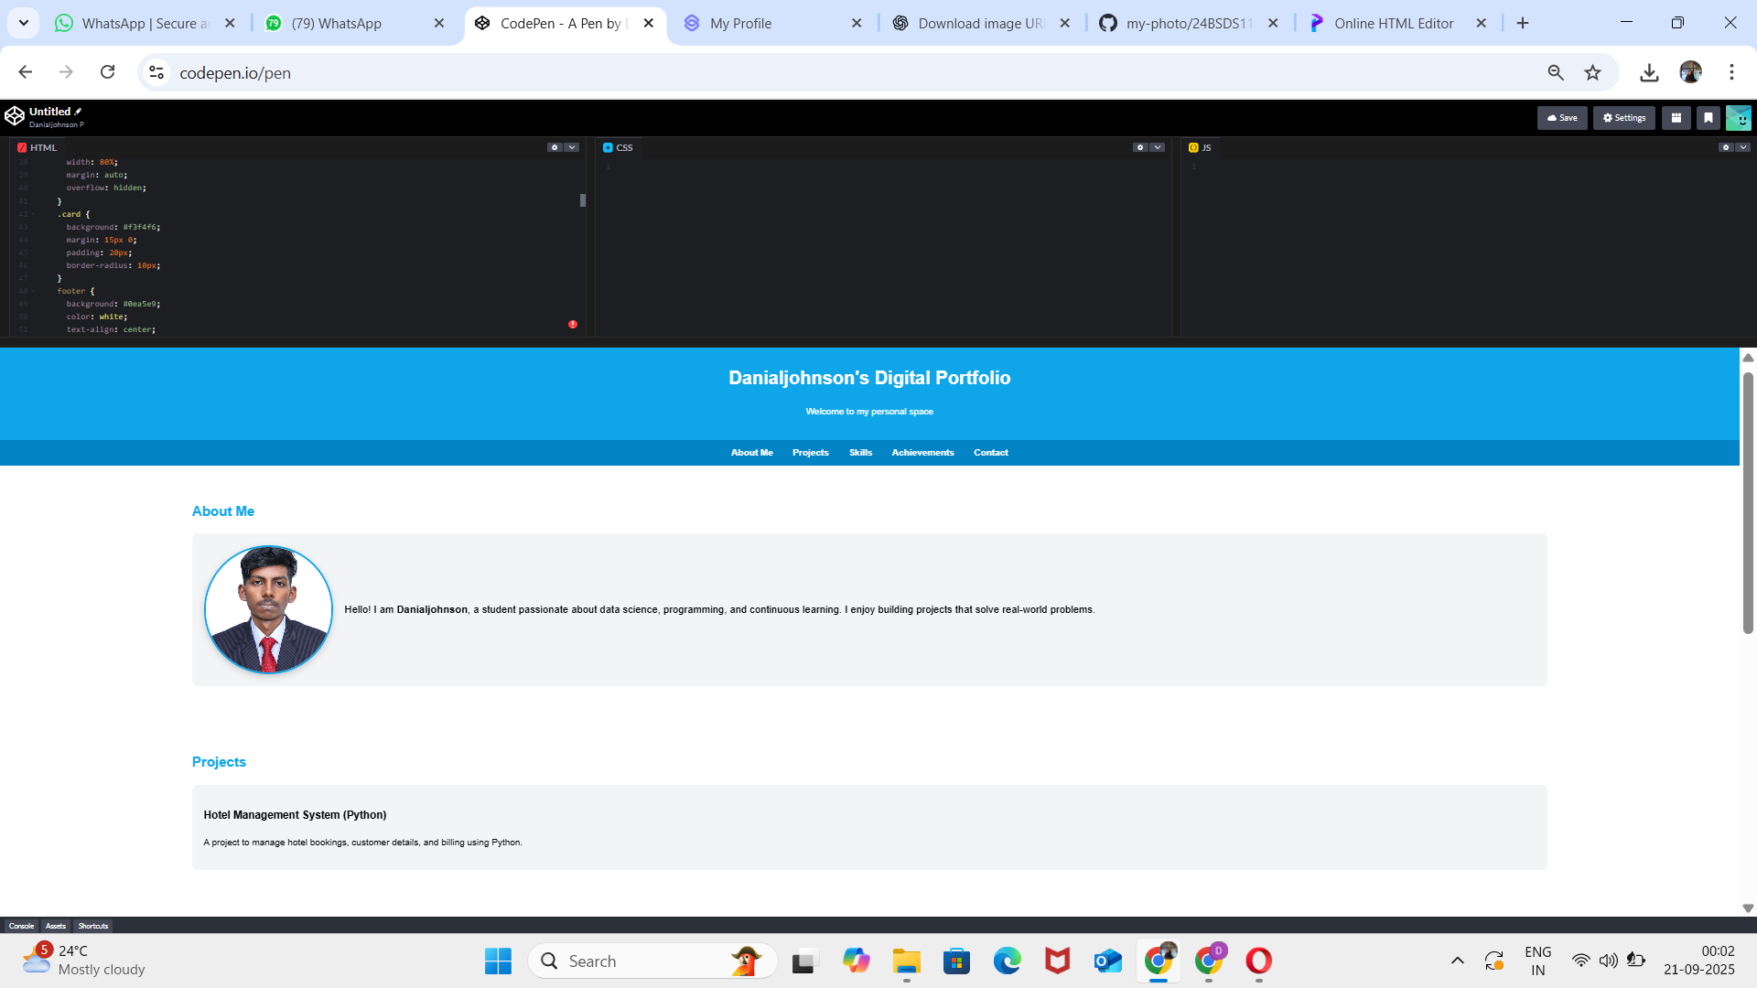

RESULTS AND SCREENSHOTS
3/21/2024 Annual Review
10

Slide 11
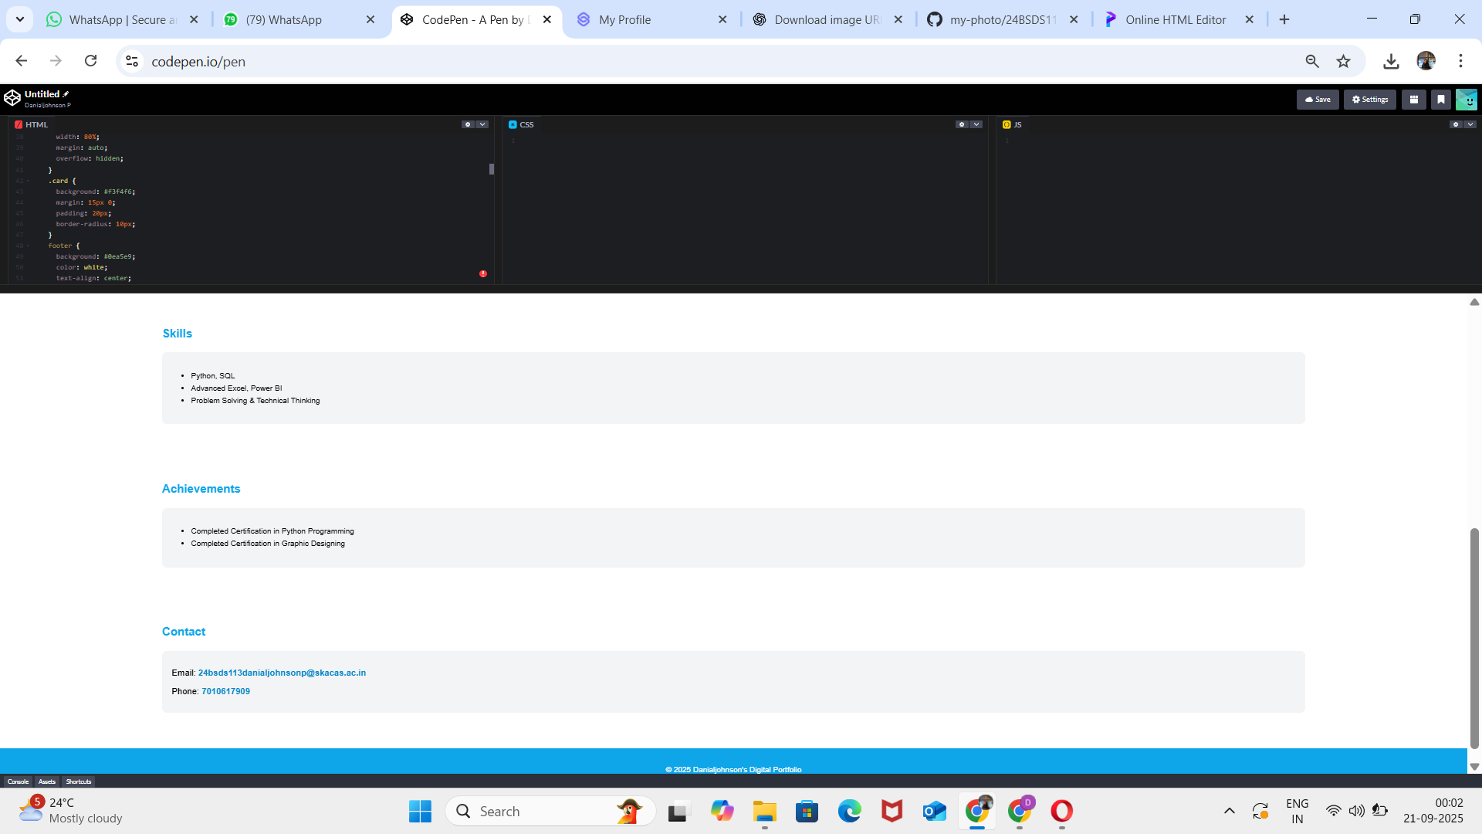

Slide 12
CONCLUSION
Built a professional portfolio website using simple web technologies.
Helps in career opportunities, academic use, and personal branding.
Can be extended with:
More projects
Dark/Light theme
Backend integration for real form submissions
12

Slide 13
Github link
https://github.com/24bsds113danialjohnsonp-crypto
13

